Slide 1
Practice School - I
Projects
Mouse Controller through Gesture Recognition
Promotional Video

Slide 2
Project 1 – OpenCV Mouse Controller
We use vision based technology where we use our fingers and laptops webcam to control all the things that a mouse does.
  It can be used to move cursor
  It can be used to operate both right as well as left buttons of the mouse
To use vision based technology we use opencv.
  used to process realtime image processing which is needed for gesture recognition

Slide 3
How it works?
we take input from webcam
convert video into images and process those images
detection of shape
Gesture recognition
Using fingers to control fingers

Slide 4
Image processing
Image smoothing
Image thesholding
Shape detection

Slide 5
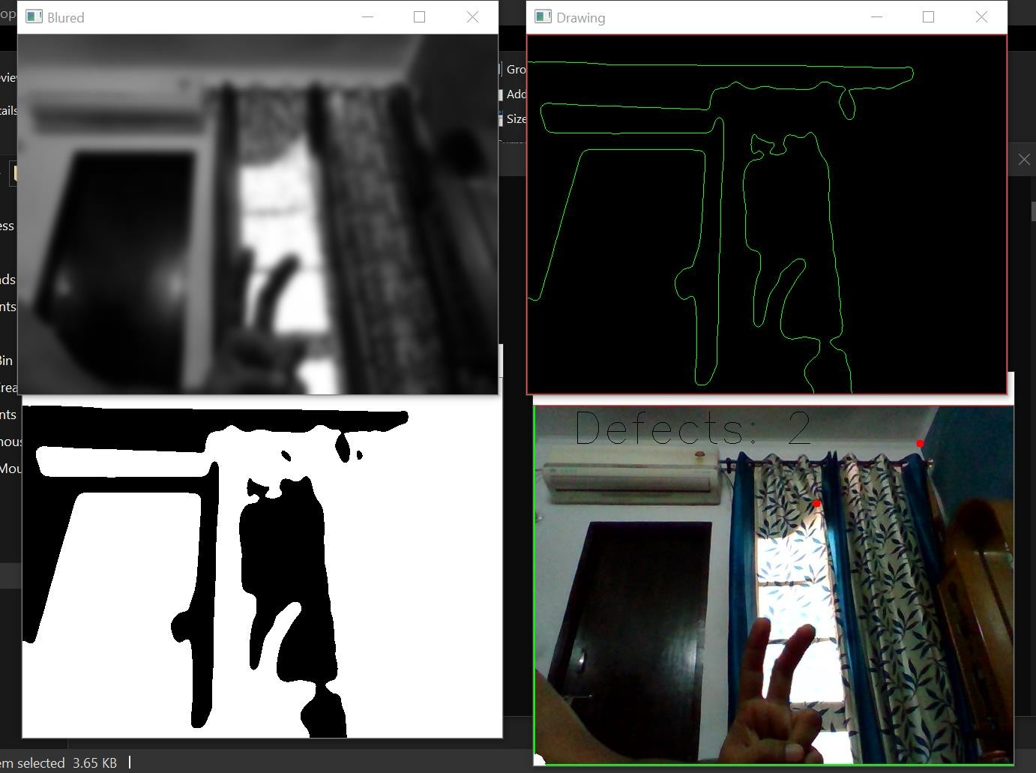
Image Smoothing
Used to remove noise from the image
we used gaussian filtering
Blurs edges

Slide 6
Image Thesholding
Forms grayscale version of image to create binary image

Slide 7
Shape Detection
Binary images are used to find shapes in the image
It returns an array with start and end point

Slide 8
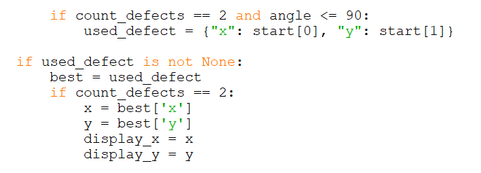
Gesture Recognition
Moving cursor - index and middle finger
Left click – all the fingers
Right click – all fingers except thumb
https://drive.google.com/file/d/1z9e338ktbHvs0it6ZZRMo4qDQgRDYnbu/view?usp=sharing

Slide 9
Project 2 – Promotional video
we created a short two minutes video
Goal was to explain why joining adhoc is useful

Slide 10
Software used
Adobe Premiere pro
Adobe After Effects
Adobe Media Encoder

Slide 11
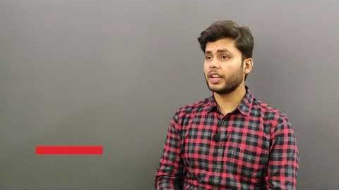
Here is the video

Slide 12
Conclusion
We also got to know about AWS, which is a cloud based computer network. We were given two projects by Adhoc Networks. Both of them were really different from what we knew before our PS – 1.

